Slide 1
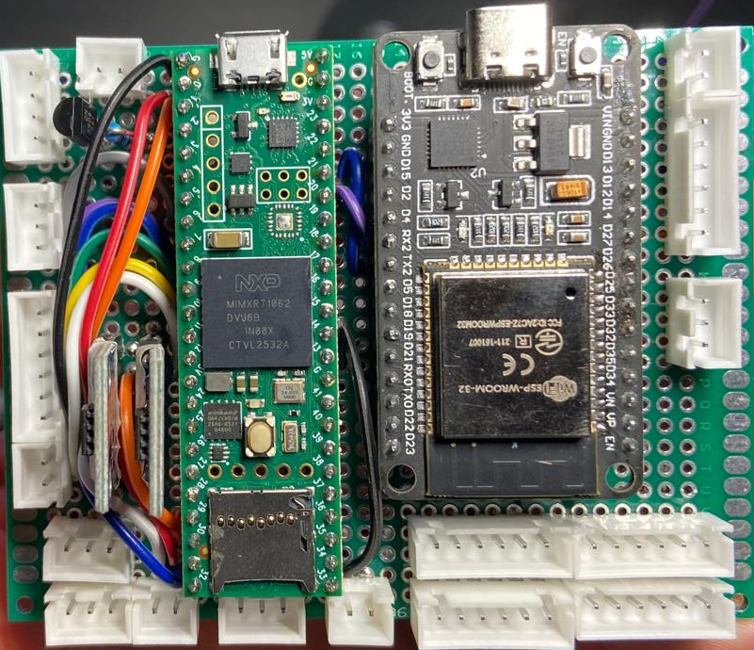
Buzzer
RGB LED
Screen
Maybe 5 pinner if INT is not needed?
ibus
Neopixel
IMU
Laser 3
Laser 4
AK45 Can + UARTs
Odrive CAN
+5V in
Laser 1
Laser 2

Slide 2
